Slide 1
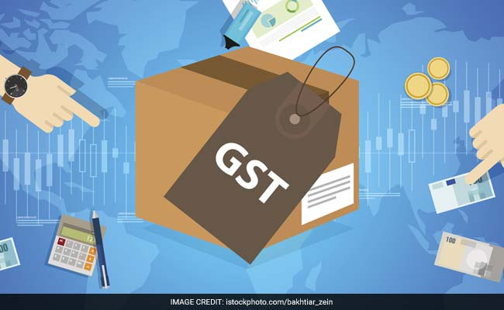


Concepts of GST:
Registration and Migration

Slide 2
Registration
    Who has to register?
    Turnover above 10 lakhs / 20 lakhs pa
    Inter-state supplier
    Required only in the state from where the supply is made
    Casual & non resident taxable persons
    Persons on whom there is responsibility of paying full tax under reverse charge e.g transport aggregator
    Electronic Commerce Operator (ECO)
    Agents

Slide 3
Aggregate Turnover
Taxable Supplies
Exempt supplies
Exports
Aggregate Turnover
Inter State supplies
Aggregate Turnover will be computed on All-India basis for same PAN

Slide 4
    Who do not have to register?
→Person engaged exclusively in non-taxable or wholly exempt from tax
→Agriculturist, in so far as supply of produce out of cultivation of land
→Persons engaged exclusively in supplies which are under RCM

Slide 5
REGISTRATION DETAILS
  Registration is
  PAN based only
  State wise separate registration
  One per state only except in case of business verticals / SEZ units
  One principal place of business has to be given. Additional places can be given
  Registration is a must within 30 days of starting business

Slide 6
How to modify registration
  CORE FIELDS
  Legal name of business
  Address of principal place or additional place of business
  Addition, deletion or retirement of partners or directors etc.,
  Can be modified only by tax authorities
  OTHER FILEDS
  → Can be modified by self

Slide 7
Pros and cons of voluntary registration
  Pros
  You can do B to B transactions
  Other registered dealers will not have to pay tax in reverse charge
  Cons
  Once registered, you have to pay taxes on all supplies, even if turnover is less than 20 lakhs
  Even if no transactions in any month, return will have to be filed

Slide 8

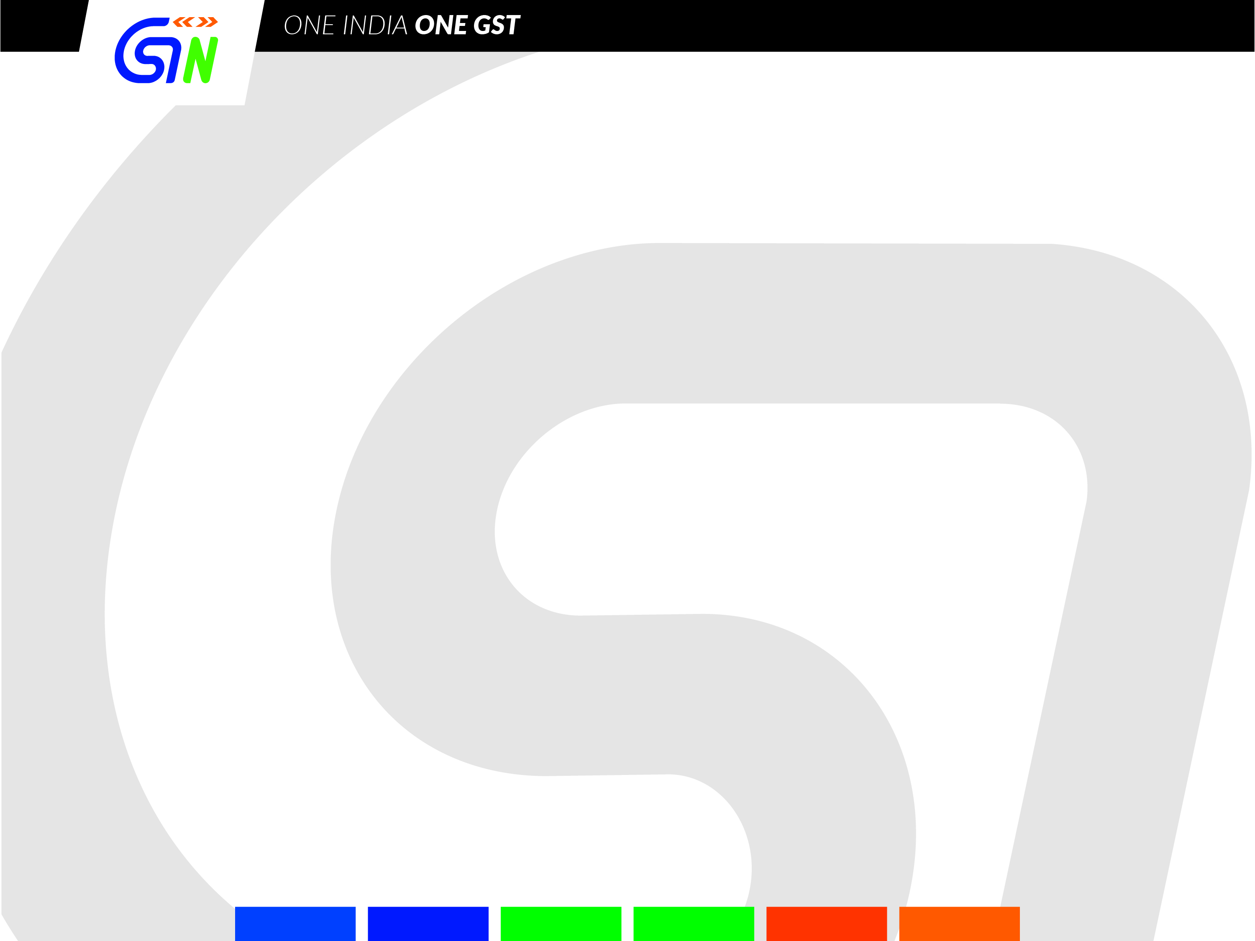
GST Portal (www.gst.gov.in)
Common portal for
  Registration
  Payment
  Return filing
  IGST Settlement data processing

Slide 9
Enrollment/Migration
Enrolment: of taxpayers registered under VAT, Service Tax, Central Excise and other taxes subsumed under GST.
Work started on 8th Nov 2016 to migrate such taxpayers by generating Prov ID (PID)
One Prov ID is generated for a PAN in a State

Slide 10
Enrollment/Migration
What is to be done by Taxpayer
  Taxpayer has to
    Activate Prov ID on GST Portal and create User ID and Password of his choice (Enrolment)
    Fill part-B GSTR REG 26) and attached relevant documents (migration)
  He can start using the Provisional ID as that is also his GSTIN (GST Identification Number).

Slide 11
Enrollment/Migration
When will I get Provisional Certificate
We have generated Provisional Certificate for all those who have activated their Provisional ID and shared it with Taxpayers by email. This number stands at 67.11 lakhs.
  Prov Certificate is also available on the dashboard of taxpayer
What is Migration and when will I get Permanent RC?
  Enrolment form has two parts. Filling up of first part makes one enrolled and generation of Provisional Certificate.
  Second part has details like “business details”, ‘Promoters details’, Place of business, bank account, Goods and services dealt etc.

Slide 12
What are the tips for getting ready for registration
Please get the documents ready with prescribed size (scanned photos of promoters, scanned image of Proof of business premises, first page of bank passbook or statement.
(Photo: 100 KB jpeg; Proof of constitution of Business: 1 MB jpeg or pdf; Proof of appointment of Auth signatory: 100 KB; Place of business: 1 MB ; Banks: 100 KB)
Online filling is simple and does not take more than 10 to 15 minutes.
The registration process is free of cost. In case you take services of tax consultant, you need to pay his/her fee only.
Once this part is filled and required documents are uploaded, you will get ARN (acknowledgement reference number).
Out of 67 lakhs 30 lakhs have completed part-B and their applications will be processed by tax officers soon for issue of Permanent Registration Certificate.
Remaining 37 lakhs taxpayers are requested to visit the portal quickly and fill up Part-B to get Permanent Registration Certificate. We are also sending email and SMS to them.

Slide 13
New Registration
  How to apply for registration?
  On common portal www.gst.gov.in
  Part A: PAN + Mobile no. + E-mail ID
Part A
On successful
verification
Application Reference Number
PAN
Mobile No
Email ID
CBDT database
OTP based verification

Slide 14
New Registration
  How to apply for registration?
Part B
Application Reference Number
Required documents
Acknowledgment
No action taken
Deficient?
No
Yes
Registration Certificate
Notice
Within 3
working days

Slide 15
New Registration
  How to apply for registration?
Response – Clarification/Documents?
Notice
Within 7
working days
Yes
No
No action taken
Deficient?
No
Yes
Registration Certificate
Rejection of Registration Application
Within 7
working days

Slide 16
Registration
What will I get after filling up the from?
  You will get ARN
  The details like PAN, Aadhaar will be matched with same with Income Tax and UIDAI
  In case of any error, email will be sent explaining the error and way to correct the same.
When will I get RC?
  Within 3 working days.
  If tax officer can’t read the lease deed or other such document or if he has a query, he will raise a query which will come to you by email.
  Please reply within 7 working days.
  Officer will get 7 working days to take decision. He cannot ask question again.

Slide 17
Thank You
The following material is available on www. cbec.gov.in
www.cbec-gst.gov.in
Presentation on GST
GST – Concept & Status
FAQs on GST in Hindi, English and 10 regional languages
CGST, UTGST, IGST & Compensation Acts
18 Rules
Constitutional Amendment Act

