Slide 1
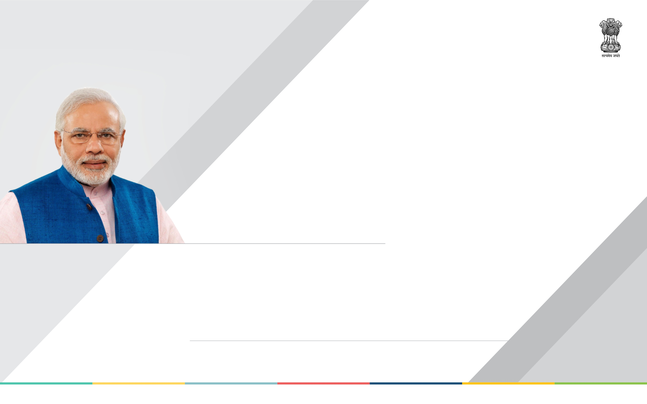
Interim report to
Shri Narendra Modi
Honorable Prime Minister, Government of India
Shri Nara Chandrababu Naidu
Chief Minister, Government of Andhra Pradesh
Convenor - Committee of Chief Ministers on Digital Payments
JANUARY 2017

Slide 2
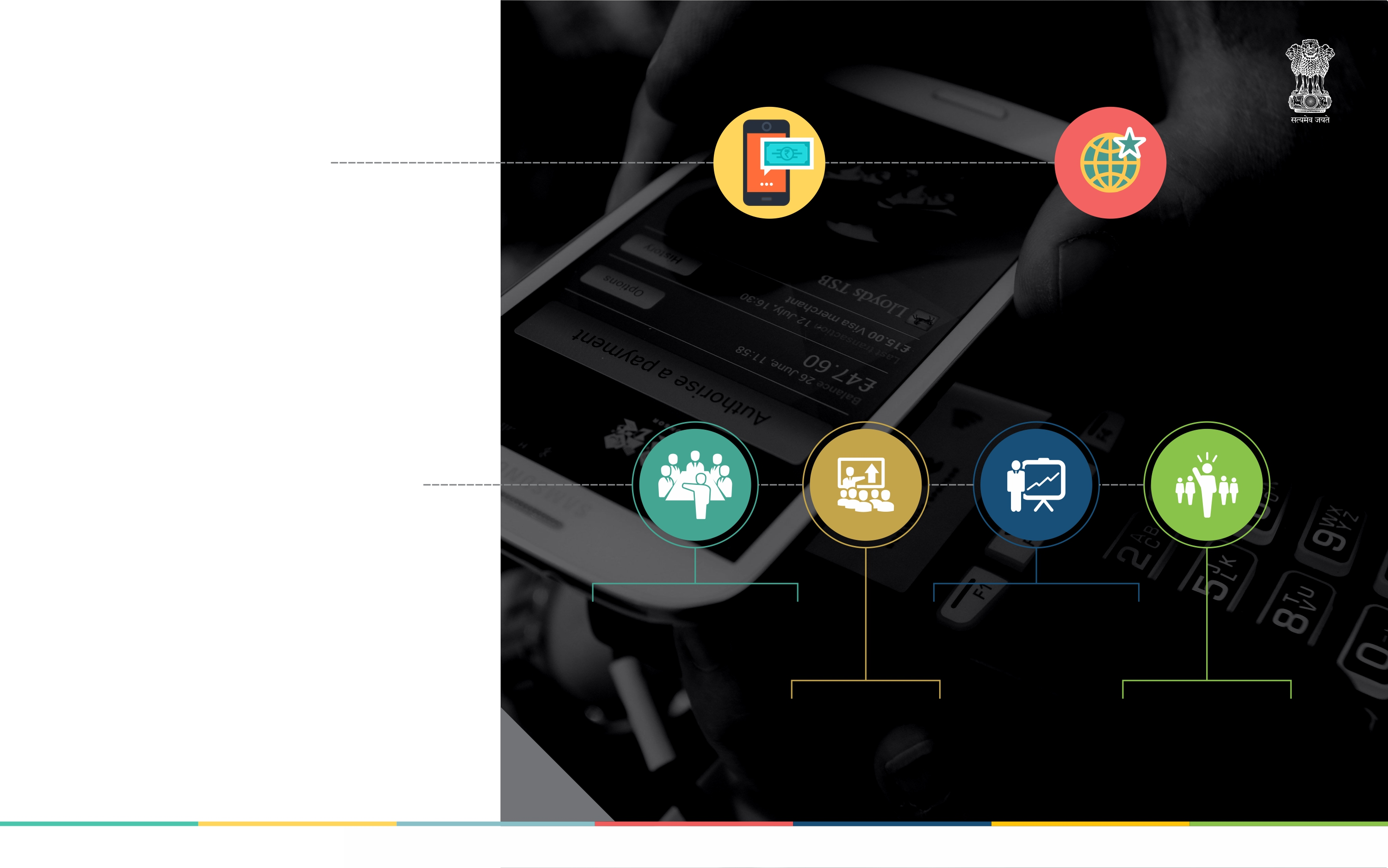
Digital
payment -
Less cash
Economy
Suggest measures to enable all sections of the population to migrate to the digital payments
Recommend measures to leapfrog into the advanced digital payment systems of global standards.
Deliberations
Committee constituted on 30th November 2016
Meetings & Video Conferences with Banks, NPCI, UIDAI, Fintech Companies and Telecom Providers.
4 meetings and Video Conferencing
Perusal of Recommendations of various committees
JANUARY 2017

Slide 3
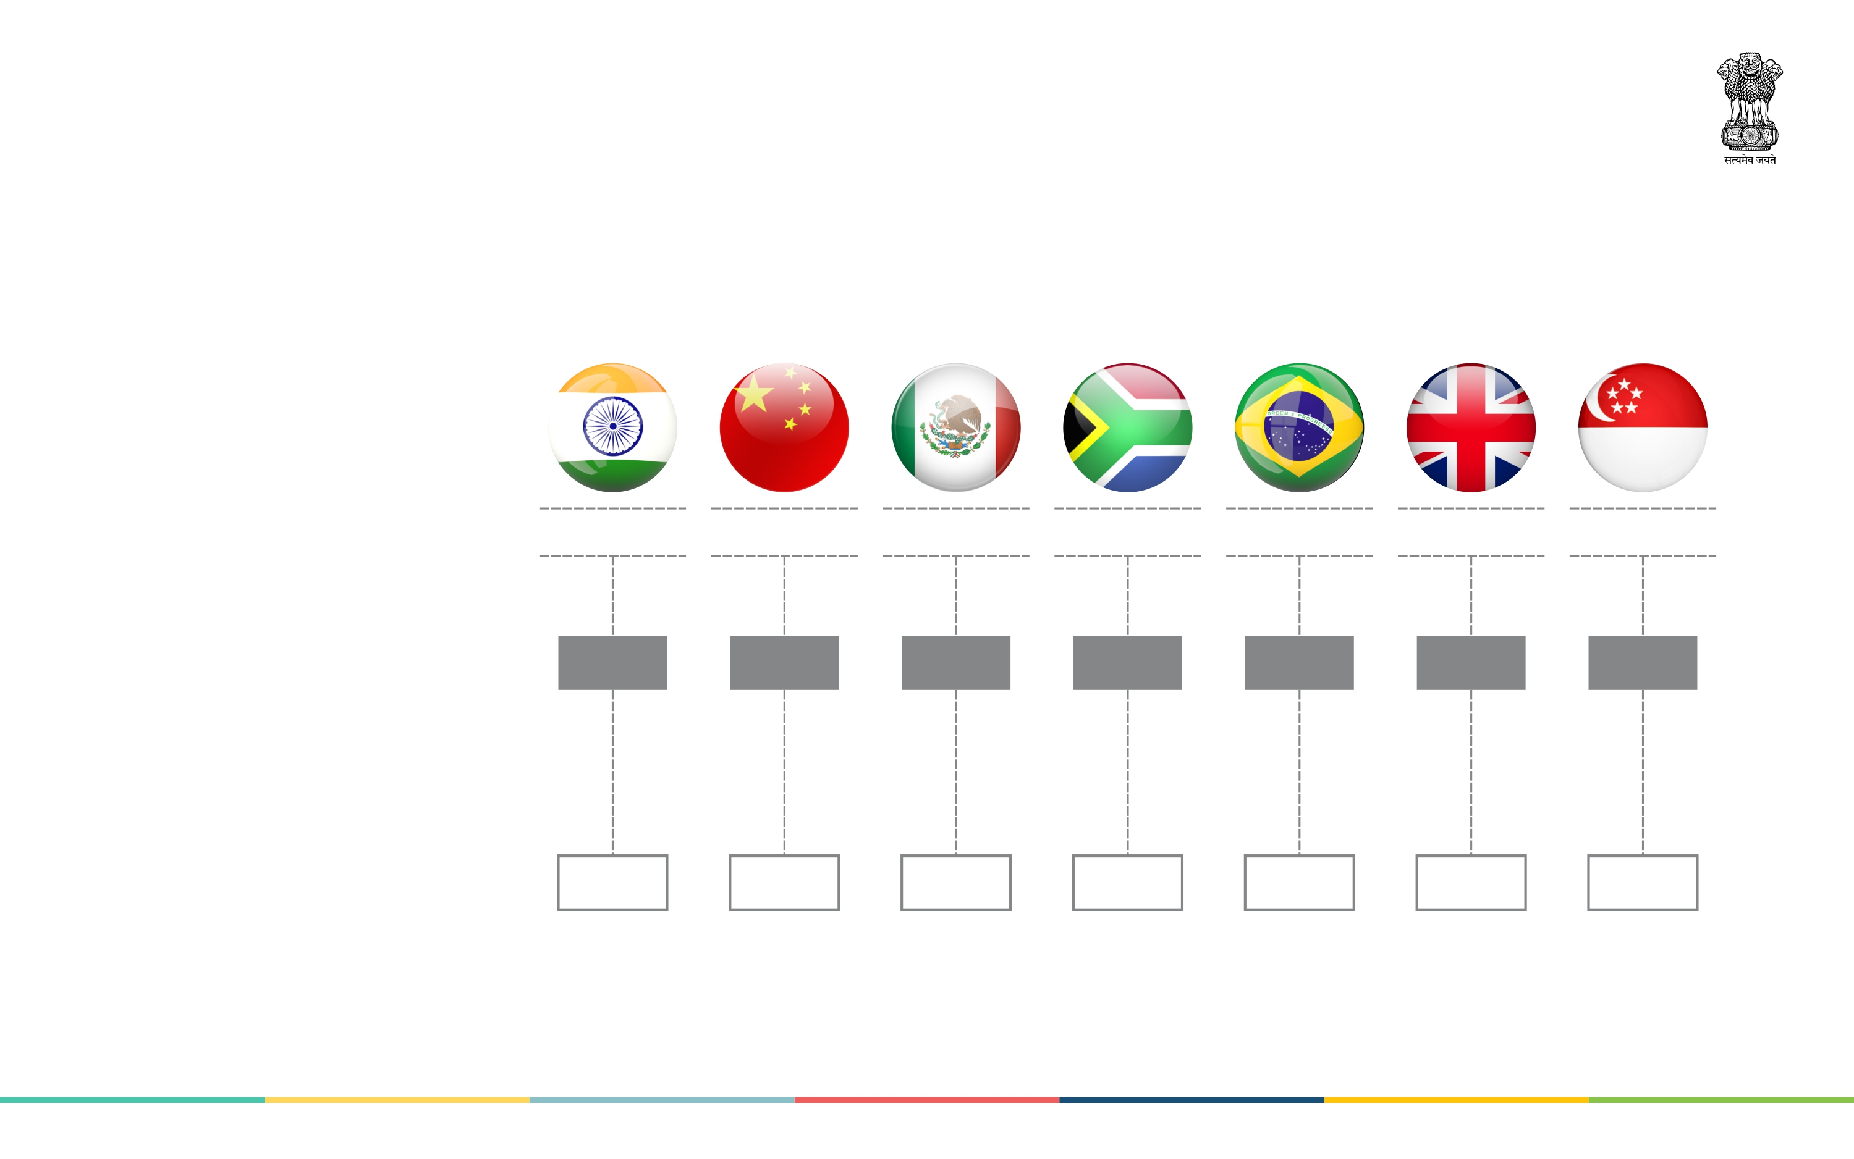
Where are we?
Country
India
China
Mexico
South Africa
Brazil
UK
Singapore
Non-cash payments transactions by non-banks per capita per annum
11
26
32
70
142
355
728
No. of pay points per
million people
1,080
16,602
7,189
7,267
25,241
30,078
31,096
JANUARY 2017

Slide 4
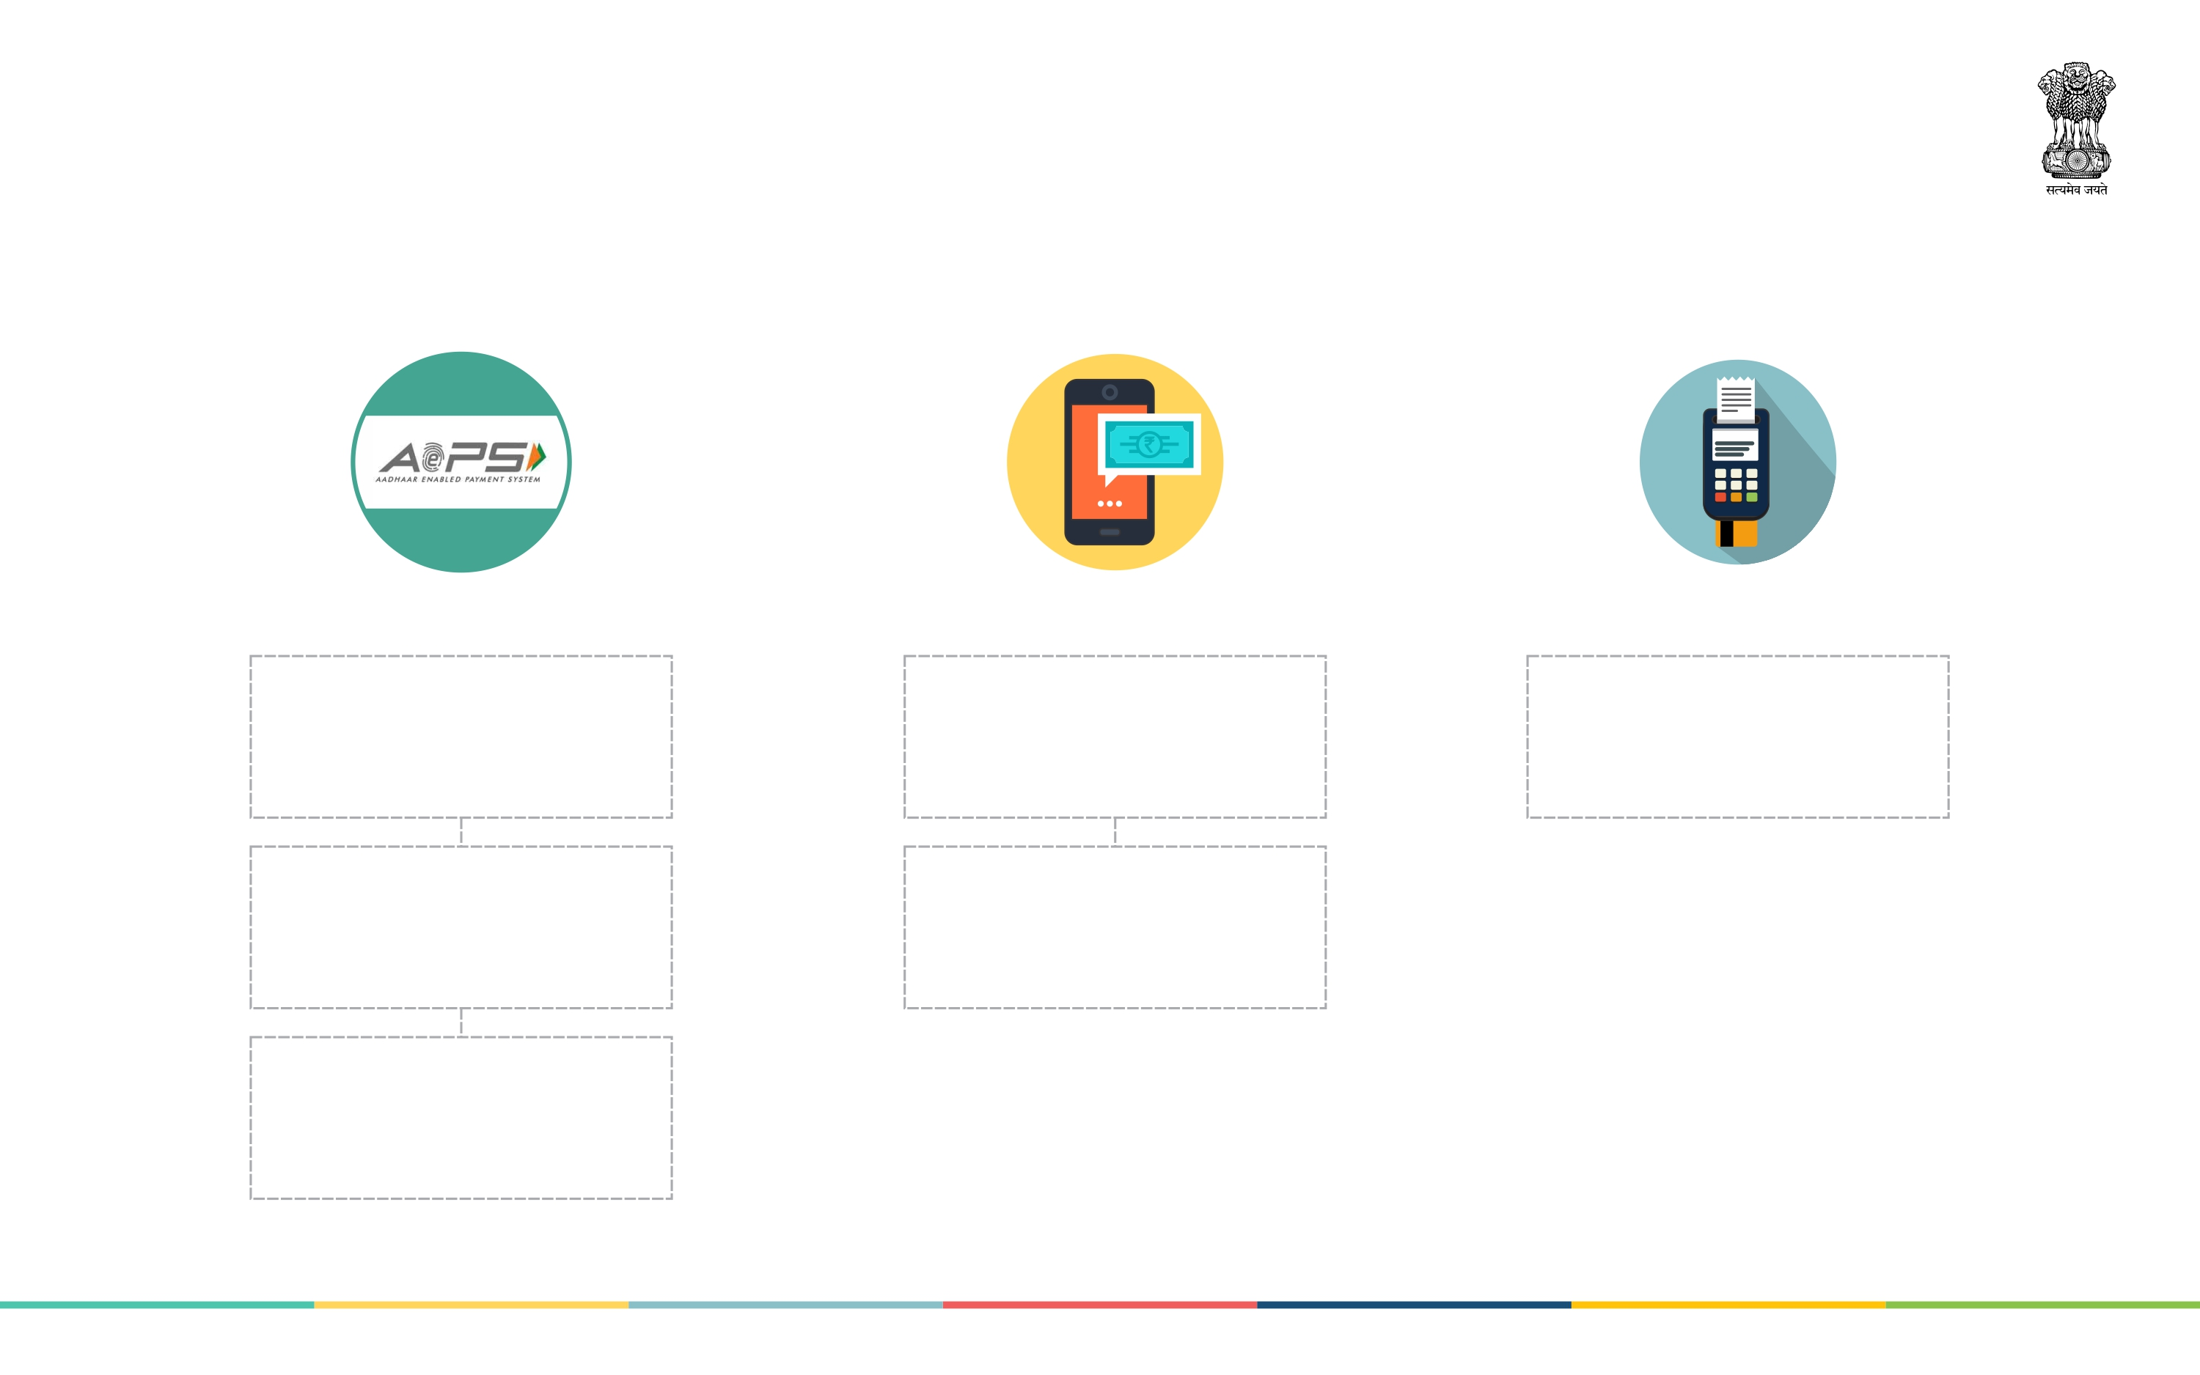
Digital Payment Modes
AEPS
Mobile phone based
Swiping
Smart phone, biometric device (only for merchant) & Aadhaar linked bank Account.
Feature phone: Simplifying USSD using Aadhaar number. NPCI to complete by month end.
Rupay, VISA, Master Card – Requirements – ePoS, mPoS, microATM and ATM
Aadhaar enabled MicroATMs across all banks business correspondent (BC) agent points
Smart Phone: UPI - Common interoperable QR Code. NPCI to complete by month end.
Seeding of bank accounts with Aadhaar bank wise - Public & Private banks.
JANUARY 2017

Slide 5
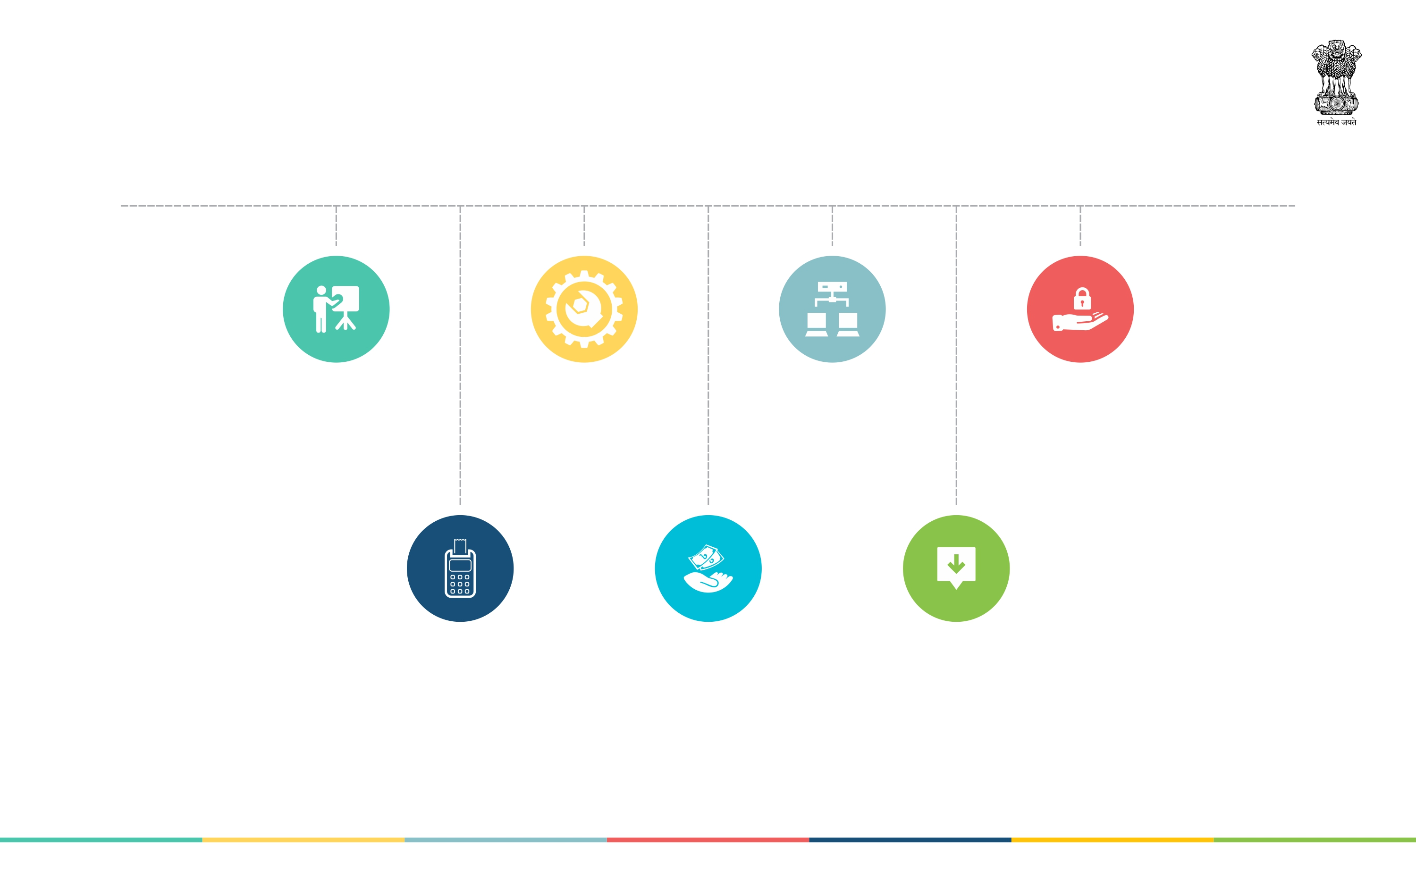
Constraints
Attitudinal
Change
and Training
Hardware including
acceptance
infrastructure
Connectivity
and Data
infrastructure
Fintech and
Cyber Security
Digital transactions
costlier than cash
Appropriate digital
payment mode for
high transaction value
Lack of
interoperability
JANUARY 2017

Slide 6
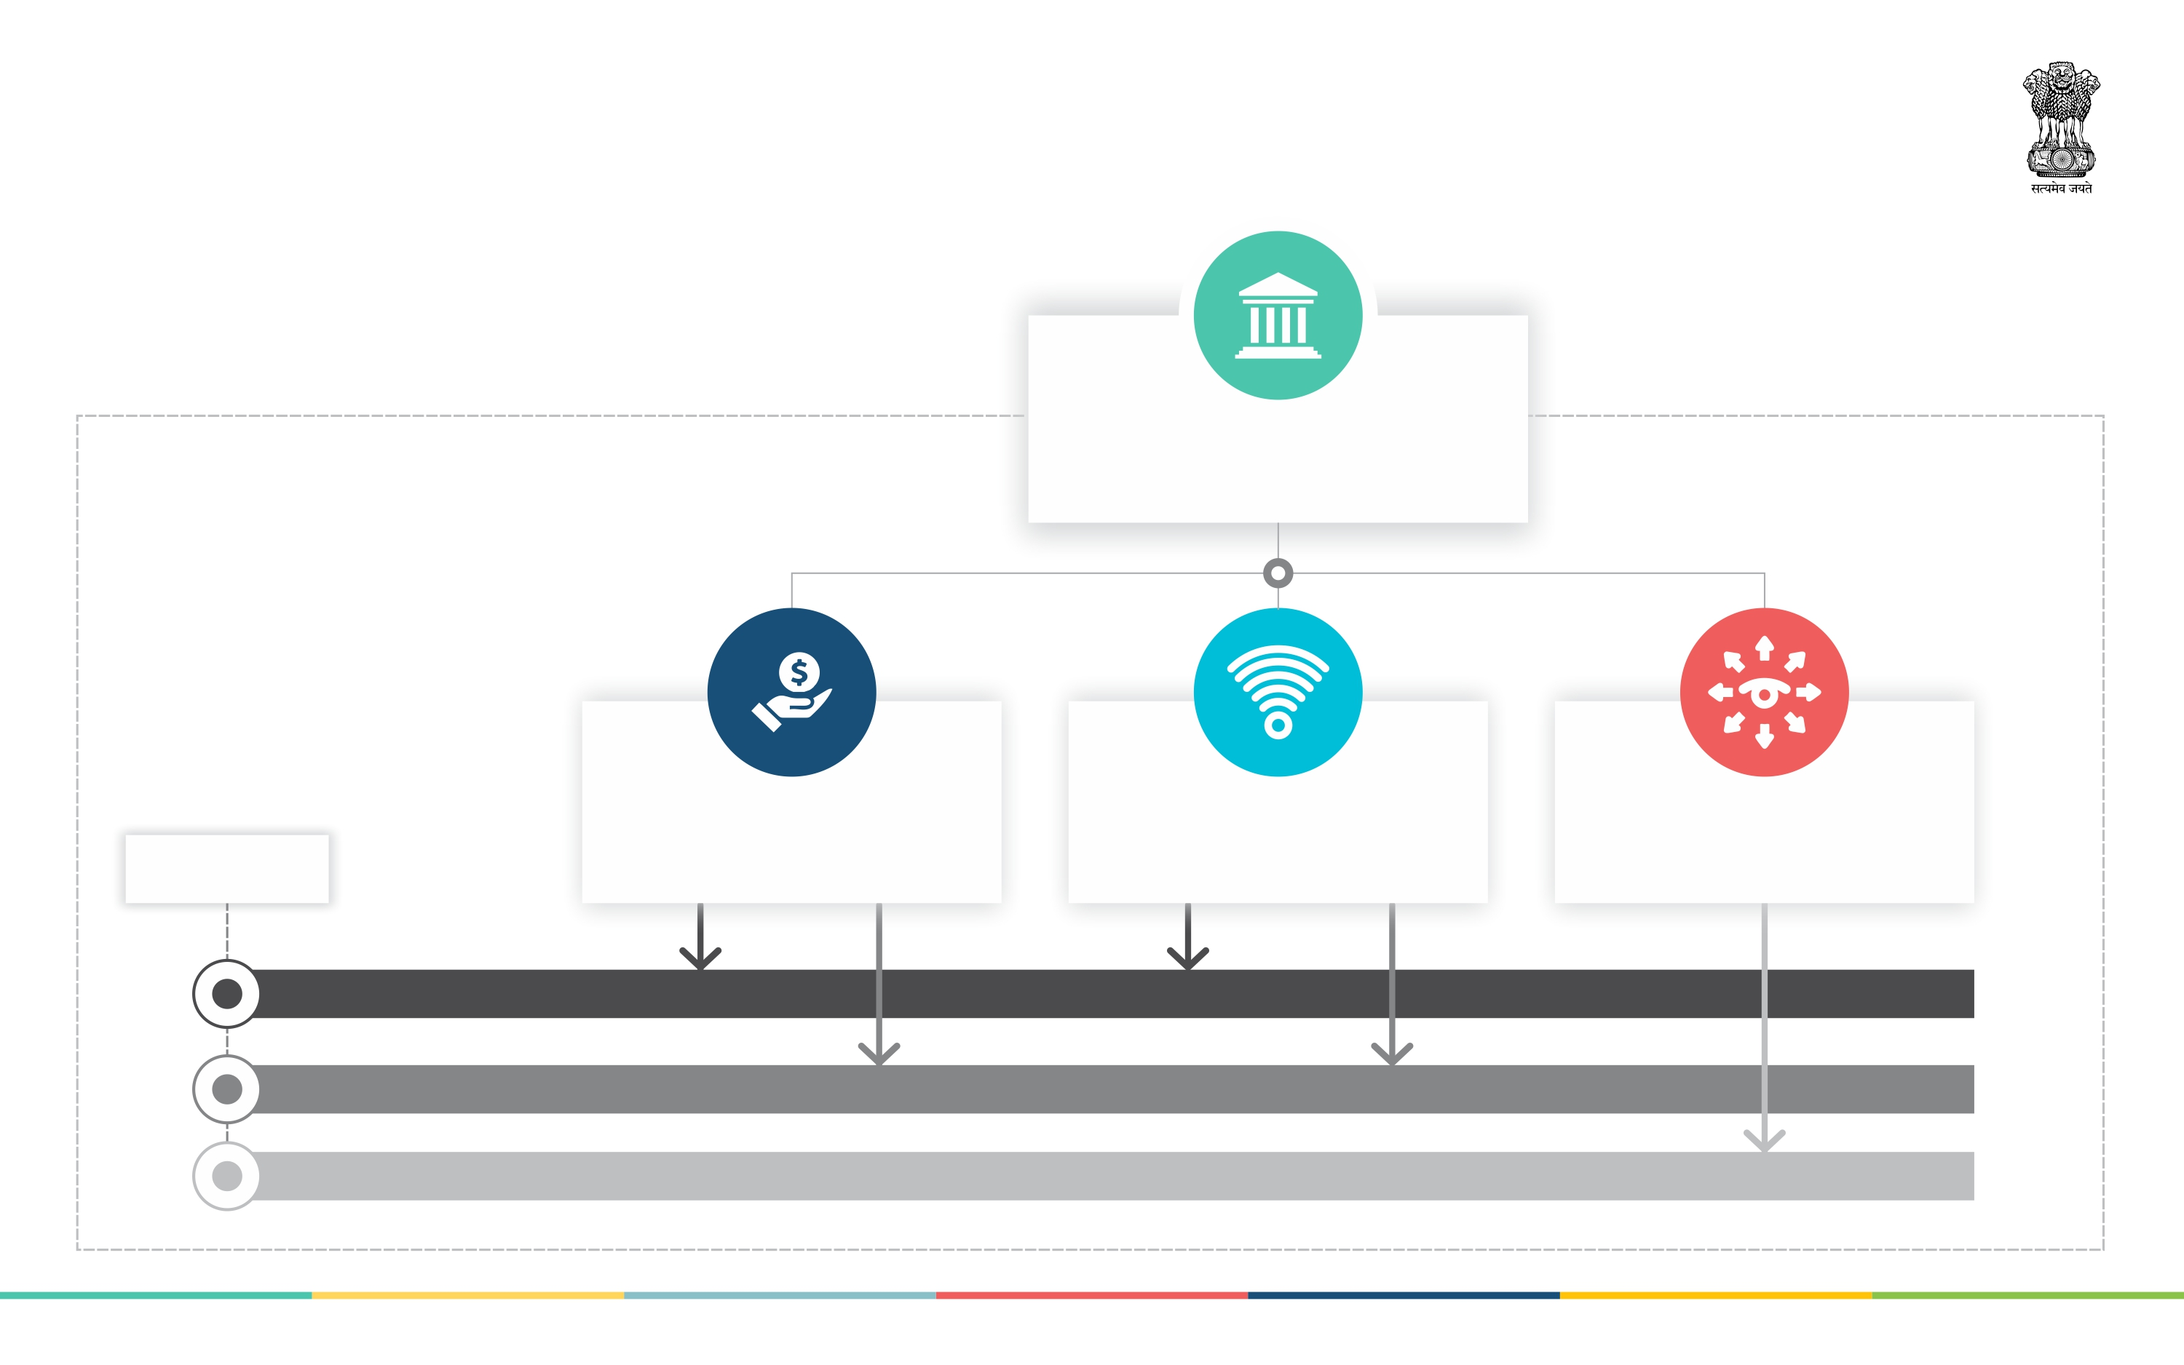
Efforts needed for
proposed actions
from key stakeholders
Government
leading the way, giving overall direction,
policy decisions & execution
Financial Entities
NPCI, RBI, Banks,
Payment gateway providers,
Telecommunication Entities
TRAI, Telecom Players,
Smartphone Players
Awareness Partners
Microfinance institutions, NGOs,
Fertilizer Corporations, PSUs & Corporates, Panchayati Raj institutions, etc.
Objectives
Strengthening Security
Expanding Infrastructure
Creating Awareness
JANUARY 2017

Slide 7
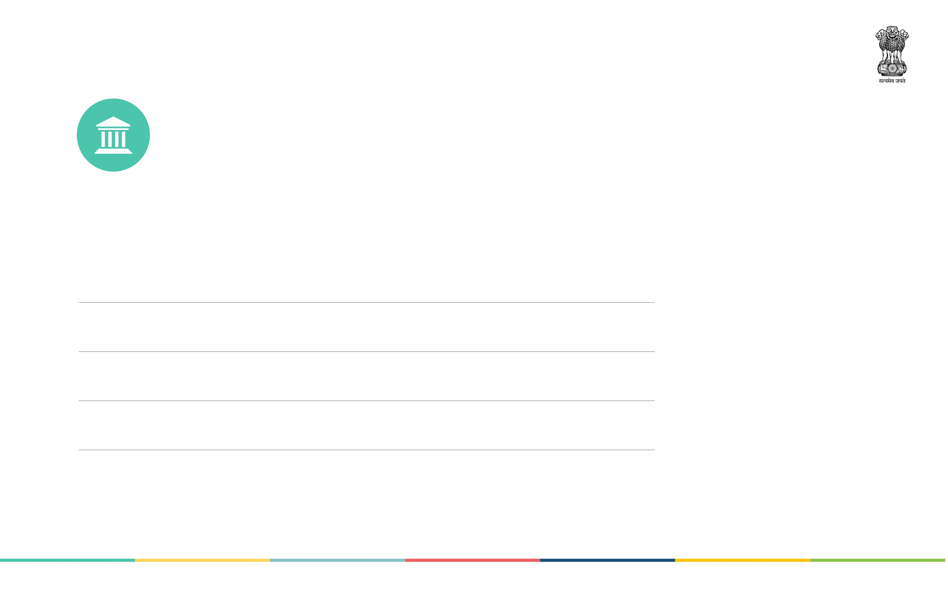
Formulate Incentive Structure
& Remove disincentives to
make digital payments more
attractive than cash
Relief in prospective taxes for encouraging merchants to accept digital payments & no retrospective taxation to Merchants doing digital transactions (Action: CBDT, DoR, MoF)
Tax incentives to be extended to Micro ATMs, Biometric Sensors etc. Domestic production to be encouraged (Action: MoF/DIPP)
Tax refund for consumers using digital payment upto a certain proportion of annual income. (Action: CBDT, DoR, MoF)
For Aadhaar Pay, Biometric (FP & Iris) sensors to be provided at 50% subsidy to all merchant points (Action: MEITY)
AEPS to be promoted by incentivising & not charging MDR (Action: RBI, NPCI)
JANUARY 2017

Slide 8
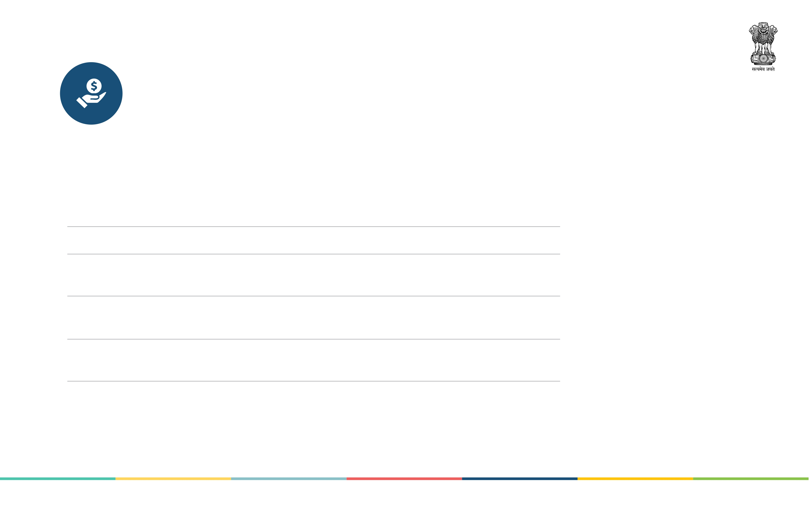
Expand & Strengthen Origination,
Acceptance, Connectivity and
Hardware Infrastructure
A subsidy of up to Rs.1000 to be provided for smart phones for non-income tax assesses or small merchants (Action: MEITY)
All payment banks and BCs to be made interoperable through AEPS (Action: DFS, RBI)
Provide infrastructure for 1,54,000 post offices by way of interoperable Aadhaar enabled Micro-ATMs. (Action: DoP)
Create fund from savings generated through cash-less transactions for incentivising acquiring bank acceptance infrastructure creation in semi-urban and rural areas (Action: DoE, MoF)
Contactless payments to be promoted for travelling in buses & suburban trains in metro cities (Action: MoUD/NITI Ayog)
UPI App should contain a common interoperable UPI QR Code. Banks to encourage the common QR Code at merchant location (Action: NPCI)
Rural and Urban Cooperative Banks should be onboarded to Digital Transactions mode immediately (Action: RBI, NABARD)
JANUARY 2017

Slide 9
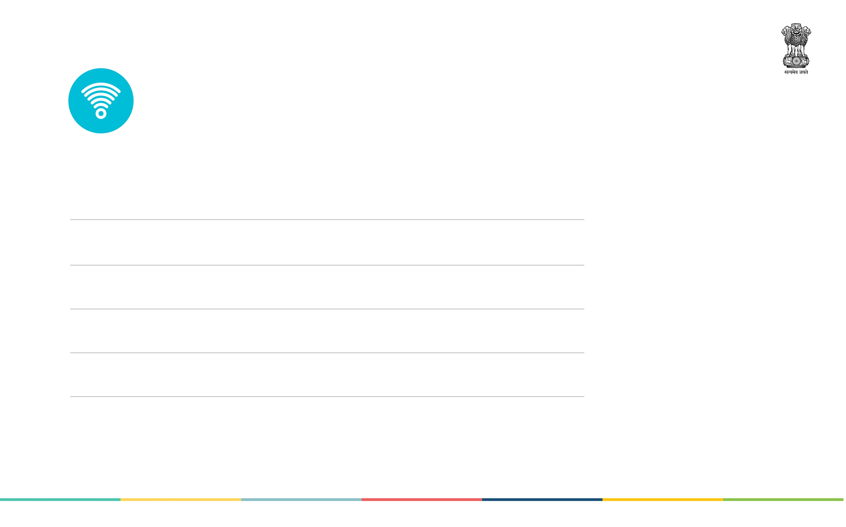
Create Authority & Formulate policy,
Regulatory changes that promote
adoption of digital payments
Committee report on MDR submitted to RBI to be considered and operationalised (Action: RBI)
Aadhaar to be made primary ID for KYC. Section 57 of Aadhaar Act can be applied. Amendment to PMLA Rules required. (Action: MoF,RBI)
To curb use of cash for large transactions consider levy of banking cash transaction Tax (BCTT) on transactions of Rs. 50,000 & above (Action: MoF)
Consider cap on maximum allowable limit of cash in all types of large ticket size transactions (Action: MoF, RBI)
All government sections like insurance, educational institutes, fertilisers, PDS, Petroleum etc to switch to digital payments (Action: All Departments)
Lower / Zero MDR for all digital payments to Government entities (Action: RBI, NPCI)
JANUARY 2017

Slide 10

Thank You
JANUARY 2017

